Slide 1
Easy Onboard
HCL, Wipro, TCS

Slide 2
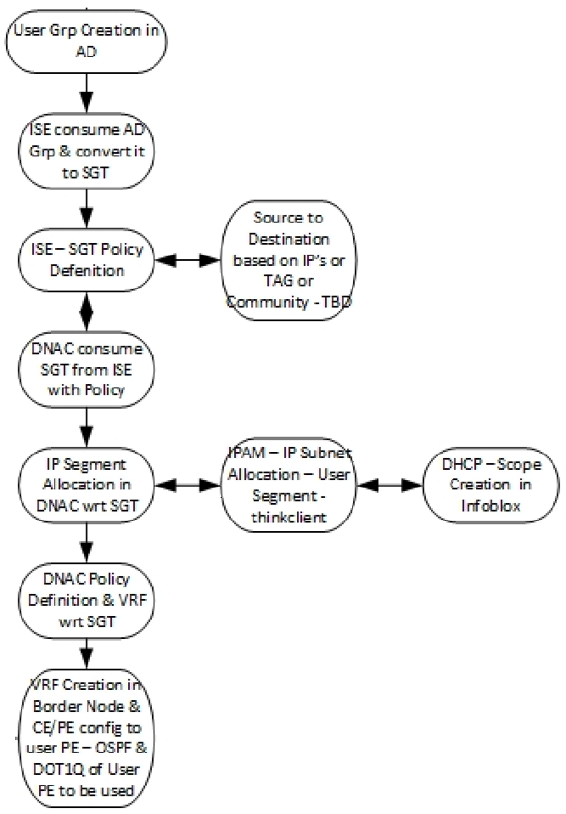
Current workflow for user onboarding at HCL

Slide 3
User Hierarchy
Vmware
HR
IT
Eng
Microsoft
HR
IT
Eng
EMC
HR
IT
Eng
OU (Organization Unit) <-> Virtual Network<->Project
User Groups <-> Scalable Group Tag <->User Type

Slide 4
Easy Onboard
IPAM/Infoblox
ISE
Active Directory
DNAC
Sync {OUs,groups,users}
Get list of OUs and groups
Is there a VN associated with the OU
Yes {VN_name, IPPrefix, Mask, SGT
List Project details
No
Get IPP,Mask for the OU
For each group in OU create SGT and associate with
group using an auth profile A
Create VN for OU with the SGTs
Associate VN with IPP, Mask
Provision devices/fabric through DNAC
Get vlan associated with VN
Now use DNAC to create policies and contracts
Associate vlan with auth profile A

Slide 5
Easy Onboard
IPAM/Infoblox
ISE
Active Directory
DNAC
Sync {OUs,groups,users}
Get list of OUs and groups
(/ers/config/activedirectory/{id}/getGroupsByDomain)
Is there a VN associated with the OU
(/api/v2/data/customer-facing-service/virtualnetworkcontext)
No
Get IPP,Mask for the OU
For each group in OU create SGT and associate with
group using an auth profile A
(/ers/config/sgt)
(/ers/config/authorizationrule)
Create VN for OU with the SGTs
(/api/v2/data/customer-facing-service/scalablegroup)
(/api/v2/data/customer-facing-service/virtualnetworkcontext)
Associate VN with IPP, Mask
(/api/v2/data/customer-facing-service/VirtualNetwork)
Provision devices/fabric through DNAC
Get vlan associated with VN
Now use DNAC to create policies and contracts
Associate vlan with auth profile A
(/api/v2/data/customer-facing-service/virtualnetworkcontext)
(/api/v2/data/customer-facing-service/scalablegroup)
(/api/v2/data/customer-facing-service/segment)
(/api/v2/ippool/{id}
List Project details
Yes {VN_name, IPPrefix, Mask, SGT}

Slide 6
Easy Onboard
IPAM/Infoblox
ISE
Active Directory
DNAC
Sync {OUs,groups,users}
(/ers/config/activedirectory/{id}/getGroupsByDomain)
Get list of OUs and groups
(/api/v2/data/customer-facing-service/virtualnetworkcontext)
Is there a VN associated with the OU
(/api/v2/data/customer-facing-service/virtualnetworkcontext) (/api/v2/data/customer-facing-service/scalablegroup)
(/api/v2/data/customer-facing-service/segment) (/api/v2/ippool/{id}
Yes {VN_name, IPPrefix, Mask, SGT
List Project details
No
(/ers/config/sgt)
Get IPP,Mask for the OU
(/ers/config/authorizationrule)
For each group in OU create SGT and associate with group using an auth profile A
Create VN for OU with the SGTs
Associate VN with IPP, Mask
Provision devices/fabric through DNAC
Get vlan associated with VN
Now use DNAC to create policies and contracts
Associate vlan with auth profile A

Slide 8
DNAC as the single point of control Possible with APIs
Active Directory (AD)
ISE
IPAM
DNAC
Application

